Slide 1
Phishing Awareness Training
Presented by
Clare Gome

Slide 2
Content
1
What is Phishing
2
Identifying Phishing attacks
3
Social engineering tactics
4
Best practices and tips
5
Quiz

Slide 3



What is Phishing
The fraudulent practice of sending emails or other messages purporting to be from reputable companies in order to induce individuals to reveal personal information, such as passwords and credit card numbers in order to induce individuals to reveal personal information, such as passwords and credit card numbers..
Learn more

Slide 4
How To Recognize Phishing (websites)
URL looks suspicious: Misspelled domain names (e.g., amaz0n.com instead of amazon.com).
No HTTPS: Secure sites use HTTPS with a padlock icon in the browser bar.
Inconsistent branding: Poor-quality logos, weird layouts, or incorrect color schemes.
Requests for sensitive info too early: Asks for passwords, credit card numbers on the homepage.
Search engine warnings: Google or your browser may flag it as unsafe.
Shortened or hidden links: Uses services like bit.ly to disguise the true URL.

Slide 5
How To Recognize Phishing (emails)
Suspicious sender address: Email address doesn't match the organization (e.g., support@secure-paypal.com instead of @paypal.com).
Urgent or threatening language: “Your account will be locked!”, “Immediate action required!”
Generic greetings: Uses “Dear Customer” instead of your name.
Unusual requests: Asks for passwords, personal info, or financial details.
Poor grammar/spelling: Legitimate companies rarely have typos.
Spoofed links: Hover over a link to see the real URL — often doesn't match the display text.

Slide 6
Social engineering tactics
1
2
3
4
5
Spear Phishing:
A targeted phishing attack using personal information (like your name, job title, or company) to make it seem more believable.
Pretexting:
Creating a fake scenario to gain trust - e.g., pretending to be IT support to ask for login credentials.
Baiting:
Offering something tempting (like free software or a USB drive) that actually delivers malware or steals data
Tailgating (Piggybacking):
Physically following someone into a restricted area without proper access (e.g., holding the door open).
Quid Pro Quo:
Offering a service in exchange for information -e.g., "I’ll fix your computer if you give me your login."
ore.

Slide 7
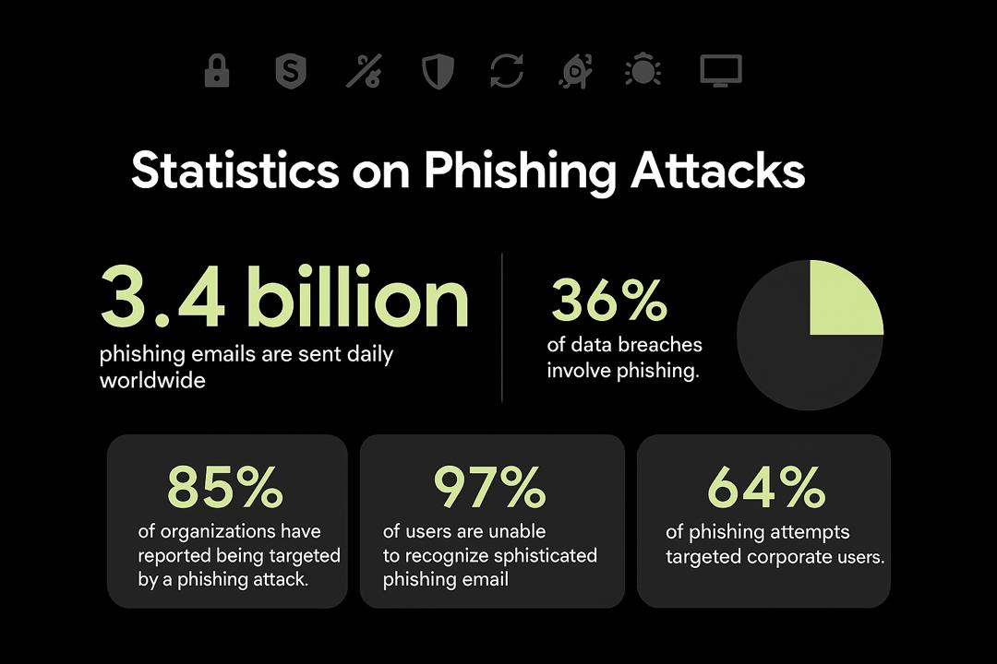
Quarter Month
Year

Slide 8
Best practices and tips
Don’t share personal info via email
Use strong, unique passwords
Check for HTTPS
Update software regularly
Avoid reusing passwords across accounts. Use a password manager if needed
Enable multi-factor authentication (MFA)
Ensure websites use HTTPS (secure connection) before entering any personal information.
Hover your mouse over links to preview the URL before clicking. Avoid clicking if it doesn't match the displayed text.
Legitimate organizations never ask for passwords, PINs, or sensitive info through email.
Keep your operating system, browser, and antivirus software up to date to patch security holes.
Bonus tip- Be cautious of urgency, phishing emails often use fear or urgency to rush you into acting.

Slide 9
Thank you

Slide 10
Phishing Awareness Short Quiz
Test your knowledge about phishing attacks.
Click to reveal answers!

Slide 11
What is a common sign of a phishing email?
An email from your boss with no spelling errors
B. An email with a suspicious link and urgent request
C. A newsletter you subscribed to
D. A thank you email from a coworker

Slide 12
What should you do if you receive a suspicious email asking for your password?
Reply and ask who they are
B. Click the link to investigate
C. Report it to your IT/security team
D. Forward it to a friend for advice

Slide 13
How can you verify a link in an email without clicking it?
Ask a friend
B. Hover your mouse over the link to preview the URL
C. Guess based on the email’s logo
D. Open the link in a private browser

Slide 14
Well Done!
Stay alert. Think before you click. Protect your data!

Slide 15
That’s right
Continue quiz

Slide 16
That’s not quite right
Try again
Continue quiz

Slide 17
That’s right
Continue quiz

Slide 18
That’s not quite right
Try again
Continue quiz

Slide 19
That’s not quite right
Try again
Continue quiz

